Slide 1
Car Rental System
Largest Online Car Rental System in Sri Lanka

Slide 2
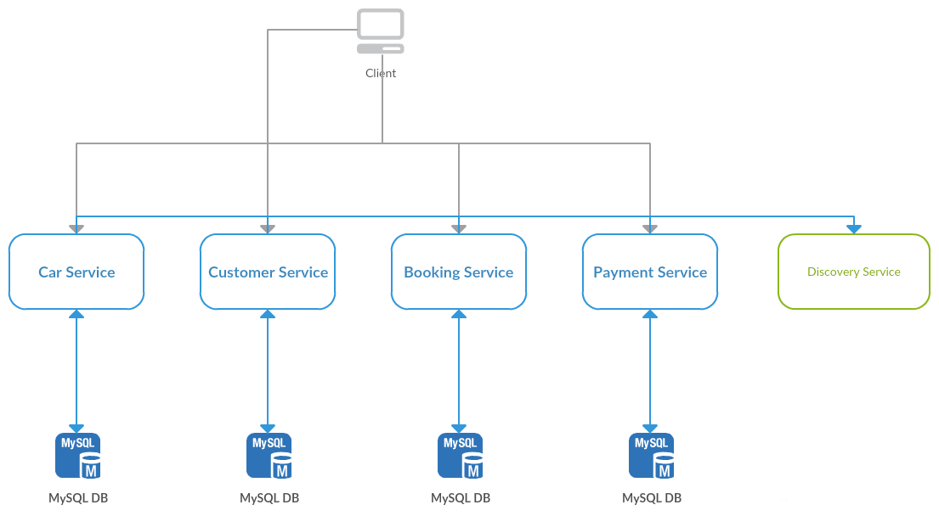

Slide 3
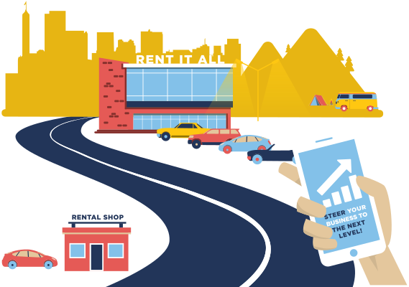
Services in the System
Car Service
Customer Service
Booking Service
Payment Service

